Slide 1
Language Modelling: Advanced Smoothing Models
Pawan Goyal
CSE, IITKGP
Week 3: Lecture 1
Language Modelling: Advanced Smoothing Mode
ls
Week 3: Lecture 1
1 / 18

Slide 2
Advanced smoothing algorithms
Some Examples
Good-Turing Kneser-Ney
Good-Turing: Basic Intuition
Use the count of things we have see once
to help estimate the count of things we have never seen
Language Modelling: Advanced Smoothing Mode
ls
Week 3: Lecture 1
2 / 18

Slide 3
N_{c}: Frequency of frequency c
Example Sentences
<s>I am here </s>
<s>who am I </s>
<s>I would like </s>
Computing N_{c}
I | 3
am | 2
here | 1 | N₁ = 4
who | 1 | N₂ = 1
would | 1 | N₃ = 1
like | 1
Language Modelling: Advanced Smoothing Mode
ls
Week 3: Lecture 1
3 / 18

Slide 4
Good Turing Estimation
Idea
Reallocate the probability mass of n−grams that occur r + 1 times in the training data to the n−grams that occur r times
In particular, reallocate the probability mass of n−grams that were seen once to the n−grams that were never seen
Adjusted count
For each count c, an adjusted count c∗ is computed as:
_{c∗ =} (c + 1)N_{c+1}
N_{c}
where N_{c} is the number of n−grams seen exactly c times
Language Modelling: Advanced Smoothing Mode
ls
Week 3: Lecture 1
4 / 18

Slide 5
Good Turing Estimation
Good Turing Smoothing
P∗_{GT} (things with frequency c) = ^{c∗}
N
_{c∗ =} (c + 1)N_{c+1}
N_{c}
What if c = 0
∗
N
P (things with frequency c) = where N denotes the total number of
1
GT N
bigrams that actually occur in training
Language Modelling: Advanced Smoothing Mode
ls
Week 3: Lecture 1
5 / 18

Slide 6
Complications
What about words with high frequency?
For small c, N_{c} > N_{c+1}
For large c, too jumpy
Simple Good-Turing
Replace empirical N_{k} with a best-fit power law once counts get unreliable
Language Modelling: Advanced Smoothing Mode
ls
Week 3: Lecture 1
6 / 18

Slide 7
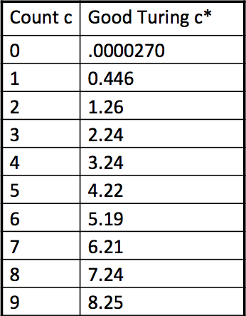
Good-Turing numbers: Example
22 million words of AP Neswire
_{c∗ =} (c + 1)N_{c+1}
N_{c}
Language Modelling: Advanced Smoothing Mode
ls
Week 3: Lecture 1
7 / 18

Slide 8
Good-Turing numbers: Example
22 million words of AP Neswire
_{c∗ =} (c + 1)N_{c+1}
N_{c}
It looks like c∗ = c − 0.75
Language Modelling: Advanced Smoothing Mode
ls
Week 3: Lecture 1
8 / 18

Slide 9
Absolute Discounting Interpolation
Why don’t we just substract 0.75 (or some d)?
c(w
, w ) − d
PAbsoluteDiscounting(wi|wi−1
) =
i−1 i
+ λ(w
)P(w )
c(w_{i−1})
i−1
i
We may keep some more values of d for counts 1 and 2
But can we do better than using the regular unigram correct?
Language Modelling: Advanced Smoothing Mode
ls
Week 3: Lecture 1
9 / 18

Slide 10
Kneser-Ney Smoothing
Intuition
Shannon game: I can’t see without my reading ...: glasses/Francisco?
“Francisco” more common that “glasses”
But “Francisco” mostly follows “San”
P(w): “How likely is w?”
Instead, P_{continuation}(w): “How likely is w to appear as a novel continuation?” For each word, count the number of bigram types it completes
Every bigram type was a novel continuation the first time it was seen
P_{continuation}(w) ∝ |{w_{i−1} : c(w_{i−1}, w) > 0}|
Language Modelling: Advanced Smoothing Mode
ls
Week 3: Lecture 1
10 / 18

Slide 11
Kneser-Ney Smoothing
How many times does w appear as a novel continuation?
P_{continuation}(w) ∝ |{w_{i−1} : c(w_{i−1}, w) > 0}|
Normalized by the total number of word bigram types
|{(w_{j−1}, w_{j}) : c(w_{j−1}, w_{j}) > 0}|
_{Pcontinuation(w) =} |{w_{i−1} : c(w_{i−1}, w) > 0}|
|{(w_{j−1}, w_{j}) : c(w_{j−1}, w_{j}) > 0}|
A frequent word (Francisco) occurring in only one context (San) will have a low continuation probability
Language Modelling: Advanced Smoothing Mode
ls
Week 3: Lecture 1
11 / 18

Slide 12
Kneser-Ney Smoothing
max(c(w
, w ) − d, 0)
PKN (wi|wi−1
) =
i−1 i
+ λ(w )P (w )
c(w_{i−1})
i−1 continuation i
λ is a normalizing constant
d
λ(w_{i−1}) = |{w : c(w_{i−1}, w) > 0}|
c(w_{i−1})
Language Modelling: Advanced Smoothing Mode
ls
Week 3: Lecture 1
12 / 18

Slide 13
Model Combination
As N increases
The power (expressiveness) of an N-gram model increases
But the ability to estimate accurate parameters from sparse data decreases (i.e. the smoothing problem gets worse).
A general approach is to combine the results of multiple N-gram models.
Language Modelling: Advanced Smoothing Mode
ls
Week 3: Lecture 1
13 / 18

Slide 14
Backoff and Interpolation
It might help to use less context
when you haven’t learned much about larger contexts
Backoff
use trigram if you have good evidence otherwise bigram, otherwise unigram
Interpolation
mix unigram, bigram, trigram
Language Modelling: Advanced Smoothing Mode
ls
Week 3: Lecture 1
14 / 18

Slide 15
Backoff
Estimating P(w_{i}|w_{i−2}w_{i−1})
If we do not have counts to compute P(w_{i}|w_{i−2}w_{i−1}) estimate this using the bigram probbaility P(w_{i}|w_{i−1})
If we do not have counts to compute P(w_{i}|w_{i−1}), estimate this using the unigram probability P(w_{i})
Pbo(wi|wi−2wi−1)=
P^{ˆ}(w_{i}|w_{i−2}w_{i−1}), if c(w_{i−2}w_{i−1}w_{i}) > 0
λ(w_{i−1}w_{i−2})P_{bo}(w_{i}|w_{i−1}), otherwise
where P_{bo}(w_{i}|w_{i−1}) = P^{ˆ}(w_{i}|w_{i−1}) if c(w_{i−1}w_{i}) > 0 λ(w_{n−1})P^{ˆ}(w_{n}), otherwise
Language Modelling: Advanced Smoothing Mode
ls
Week 3: Lecture 1
15 / 18

Slide 16
Example Problem
In a corpus, suppose there are 4 words, a, b, c, and d. You are provided with the following counts.
n-gram | count | n-gram | count | n-gram | count
aba | 4 | ba | 5 | a | 8
abb | 0 | bb | 3 | b | 9
abc | 0 | bc | 0 | c | 8
abd | 0 | bd | 0 | d | 7
Use the recursive definition of backoff smoothing to obtain the probability distribution, P_{backoff} (w_{n}|w_{n−2}w_{n−1}), where w_{n−1} = b and w_{n−2} = a.
Also assume that P^{ˆ}(x) = P(x) − 1/8.
Language Modelling: Advanced Smoothing Mode
ls
Week 3: Lecture 1

Slide 17
Linear Interpolation
Simple Interpolation
P˜(w_{n}|w_{n−1}w_{n−2}) = λ₁P(w_{n}|w_{n−1}w_{n−2}) + λ₂P(w_{n}|w_{n−1}) + λ₃P(w_{n})
∑λ_{i} = 1
i
Lambdas conditional on context
P˜(w_{n}|w_{n−1}w_{n−2}) = λ₁(w_{n−2}, w_{n−1})P(w_{n}|w_{n−1}w_{n−2})
+λ₂(w_{n−2}, w_{n−1})P(w_{n}|w_{n−1}) + λ₃(w_{n−2}, w_{n−1})P(w_{n})
Language Modelling: Advanced Smoothing Mode
ls
Week 3: Lecture 1
17 / 18

Slide 18
Setting the lambda values
Use a held-out corpus
Choose λs to maximize the probability of held-out data: Find the N-gram probabilities on the training data
Search for λs that give the largest probability to held-out data
Language Modelling: Advanced Smoothing Mode
ls
Week 3: Lecture 1
18 / 18

Slide 19
Computational Morphology
Pawan Goyal
CSE, IITKGP
Week 3: Lecture 2
Computational Morphology
Week 3: Lecture 2
1 / 19

Slide 20
Morphology
Morphology studies the internal structure of words, how words are built up from smaller meaningful units called morphemes
dogs
2 morphemes, ‘dog’ and ‘s’
‘s’ is a plural marker on nouns
unladylike
3 morphemes
un- ‘not’
lady ‘well-behaved woman’
-like ‘having the characteristic of’
Computational Morphology
Week 3: Lecture 2
2 / 19

Slide 21
Allomorphs
Variants of the same morpheme, but cannot be replaced by one another
Example
opposite: un-happy, in-comprehensible, im-possible, ir-rational
Computational Morphology
Week 3: Lecture 2
3 / 19

Slide 22
Bound and Free Morphemes
Bound
Cannot appear as a word by itself.
-s (dog-s), -ly (quick-ly), -ed (walk-ed)
Free
Can appear as a word by itself; often can combine with other morphemes too.
house (house-s), walk (walk-ed), of, the, or
Computational Morphology
Week 3: Lecture 2
4 / 19

Slide 23
Stems and Affixes
Stems and Affixes
Stems (roots): The core meaning bearing units
Affixes: Bits and pieces adhering to stems to change their meanings and grammatical functions
Mostly, stems are free morphemes and affixes are bound morphemes
Computational Morphology
Week 3: Lecture 2
5 / 19

Slide 24
Types of affixes
Prefix: un-, anti-, etc (a-, ati-, pra- etc.)
un-happy, pre-existing
Suffix: -ity, -ation, etc (-taa, -ke, -ka etc.)
talk-ing, quick-ly
Infix: ‘n’ in ‘vindati’ (he knows), as contrasted with vid (to know).
Philippines: basa ‘read’ → b-um-asa ‘read’ English: abso-bloody-lutely (emphasis)
Circumfixes - precedes and follows the stem
Dutch: berg ‘mountain’, ge-berg-te ‘mountains’
Computational Morphology
Week 3: Lecture 2
6 / 19

Slide 25
Content and functional morphemes
Content morphemes
Carry some semantic content
car, -able, un-
Functional morphemes
Provide grammatical information
-s (plural), -s (3rd singular)
Computational Morphology
Week 3: Lecture 2
7 / 19

Slide 26
Inflectional and Derivational Morphology
Two different kind of relationship among words
Inflectional morphology
Grammatical: number, tense, case, gender
Creates new forms of the same word: bring, brought, brings, bringing
Derivational morphology
Creates new words by changing part-of-speech: logic, logical, illogical, illogicality, logician
Fairly systematic but some derivations missing: sincere - sincerity, scarce - scarcity, curious - curiosity, fierce - fiercity?
Computational Morphology
Week 3: Lecture 2
8 / 19

Slide 27
Morphological processes
Concatenation
Adding continuous affixes - the most common process:
hope+less, un+happy, anti+capital+ist+s
Often, there are phonological/graphemic changes on morpheme boundaries: book + s [s], shoe + s [z]
happy +er → happier
Computational Morphology
Week 3: Lecture 2
9 / 19

Slide 28
Morphological processes
Reduplication: part of the word or the entire word is doubled Nama: ‘go’ (look), ‘go-go’ (examine with attention) Tagalog: ‘basa’ (read), ‘ba-basa’(will read)
Sanskrit: ‘pac’ (cook), ‘papa¯ ca’ (perfect form, cooked)
Phrasal reduplication (Telugu): pillava¯ d. u nad. ustu¯ nad. ustu¯ pad. i po¯ ya¯ d. u
(The child fell down while walking)
Computational Morphology
Week 3: Lecture 2
10 / 19

Slide 29
Morphological processes
Suppletion
‘irregular’ relation between the words
go - went, good - better
Morpheme internal changes
The word changes internally
sing - sang - sung, man - men, goose - geese
Computational Morphology
Week 3: Lecture 2
11 / 19

Slide 30
Word Formation
Compounding
Words formed by combining two or more words Example in English:
Adj + Adj → Adj: bitter-sweet N + N → N: rain-bow
V + N → V: pick-pocket P + V → V: over-do
Particular to languages
room-temperature: Hindi translation?
Computational Morphology
Week 3: Lecture 2

Slide 31
Word Formation
Acronyms
laser: Light Amplification by Simulated Emission of Radiation
Blending
Parts of two different words are combined breakfast + lunch → brunch
smoke + fog → smog motor + hotel → motel
Clipping
Longer words are shortened
doctor, laboratory, advertisement, dormitory, examination, bicycle, refrigerator
Computational Morphology
Week 3: Lecture 2
13 / 19

Slide 32
Processing morphology
Lemmatization: word → lemma saw → {see, saw}
Morphological analysis : word → setOf(lemma +tag) saw → { <see, verb.past>, < saw, noun.sg>}
Tagging: word → tag, considers context
Peter saw her → { <see, verb.past>} Morpheme segmentation: de-nation-al-iz-ation Generation: see + verb.past → saw
Computational Morphology
Week 3: Lecture 2
14 / 19

Slide 33
What are the applications?
Text-to-speech synthesis:
lead: verb or noun?
read: present or past?
Search and information retrieval Machine translation, grammar correction
Computational Morphology
Week 3: Lecture 2
15 / 19

Slide 34
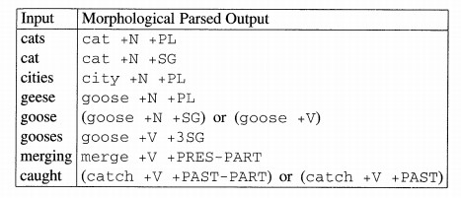
Morphological Analysis
Goal
To take input forms like those in the first column and produce output forms like those in the second column.
Output contains stem and additional information; +N for noun, +SG for singular, +PL for plural, +V for verb etc.
Computational Morphology
Week 3: Lecture 2
16 / 19

Slide 35
Issues involved
boy → boys
fly → flys → flies (y→ i rule)
Toiling → toil Duckling → duckl?
Getter → get + er Doer → do + er Beer → be + er?
Computational Morphology
Week 3: Lecture 2
17 / 19

Slide 36
Knowledge Required
Knowledge of stems or roots Duck is a possible root, not duckl. We need a dictionary (lexicon)
Morphotactics
Which class of morphemes follow other classes of morphemes inside the word?
Ex: plural morpheme follows the noun
Only some endings go on some words
Do+er: ok
Be+er: not so
Spelling change rules
Adjust the surface form using spelling change rules
Get + er → getter
Fox + s foxes
Computational Morphology
Week 3: Lecture 2
18 / 19

Slide 37
Why can’t this be put in a big lexicon?
English: just 317,477 forms from 90,196 lexical entries, a ratio of 3.5:1
Sanskrit: 11 million forms from a lexicon of 170,000 entries, a ratio of 64.7:1
New forms can be created, compounding etc.
One of the most common methods is finite-state-machines
Computational Morphology
Week 3: Lecture 2
19 / 19

Slide 38
Finite-state methods for morphology
Pawan Goyal
CSE, IITKGP
Week 3: Lecture 3
Finite-state methods for morphology
Week 3: Lecture 3
1 / 18

Slide 39
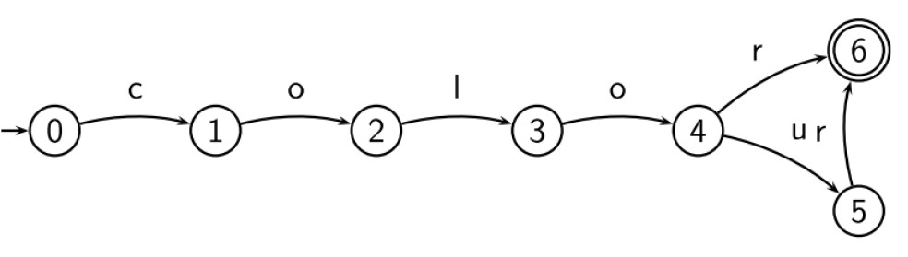
Finite State Automaton (FSA)
What is FSA?
A kind of directed graph
Nodes are called states, edges are labeled with symbols (possibly empty
s)
Start state and accepting states
Recognizes regular languages, i.e., languages specified by regular expressions
Finite-state methods for morphology
Week 3: Lecture 3
2 / 18

Slide 40
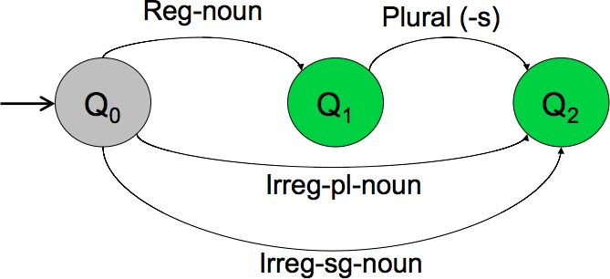
FSA for nominal inflection in English
Finite-state methods for morphology
Week 3: Lecture 3
3 / 18

Slide 41
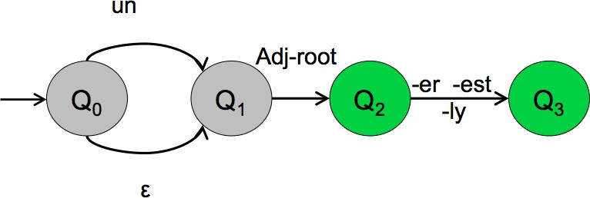
FSA for English Adjectives
Word modeled
happy, happier, happiest, real, unreal, cool, coolly, clear, clearly, unclear, unclearly, ...
Finite-state methods for morphology
Week 3: Lecture 3
4 / 18

Slide 42
Morphotactics
The last two examples model some parts of the English morphotactics But what about the information about regular and irregular roots?
Lexicon
Can we include the lexicon in the FSA?
Finite-state methods for morphology
Week 3: Lecture 3
5 / 18

Slide 43
FSA for nominal inflection in English
Finite-state methods for morphology
Week 3: Lecture 3
6 / 18

Slide 44
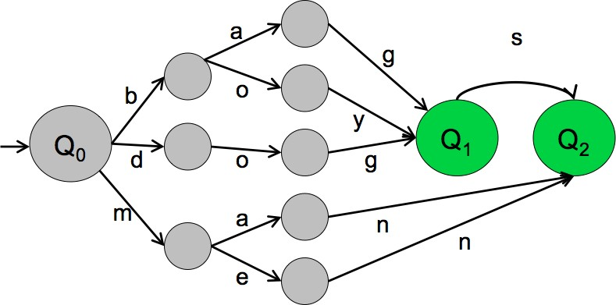
After adding a mini-lexicon
Finite-state methods for morphology
Week 3: Lecture 3
7 / 18

Slide 45
Some properties of FSAs: Elegance
Recognizing problem can be solved in linear time (independent of the size of the automaton)
There is an algorithm to transform each automaton into a unique equivalent automaton with the least number of states
An FSA is deterministic iff it has no empty (s) transition and for each state and each symbol, there is at most one applicable transition
Every non-deterministic automaton can be transformed into a deterministic one
Finite-state methods for morphology
Week 3: Lecture 3
8 / 18

Slide 46
But ...
FSAs are language recognizers/generators.
We need transducers to build Morphological Analyzers
Finite State Transducers
Translate strings from one language to strings in another language
Like FSA, but each edge is associated with two strings
Finite-state methods for morphology
Week 3: Lecture 3
9 / 18

Slide 47
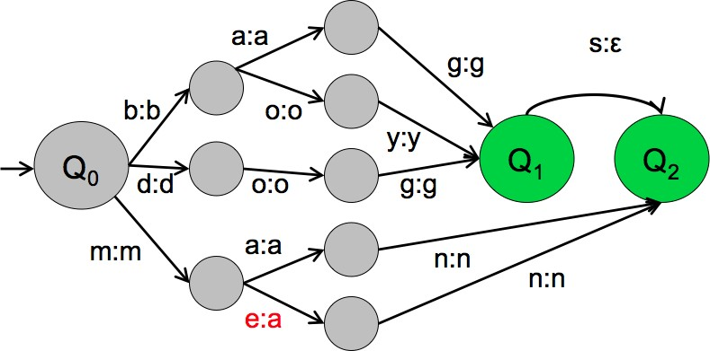
An example FST
Finite-state methods for morphology
Week 3: Lecture 3

Slide 48

Two-level morphology
Given the input cats, we would like to output cat+N+PL, talling us that cat is a plural noun.
We do this via a version of two-level morphology, a correspondence between a lexical level (morphemes and features) to a surface level (actual spelling).
Finite-state methods for morphology
Week 3: Lecture 3

Slide 49
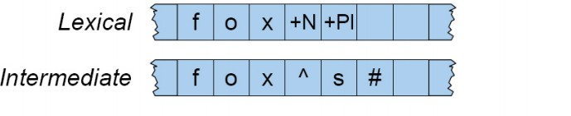
Intermediate tape for Spelling change rules
Finite-state methods for morphology
Week 3: Lecture 3

Slide 50
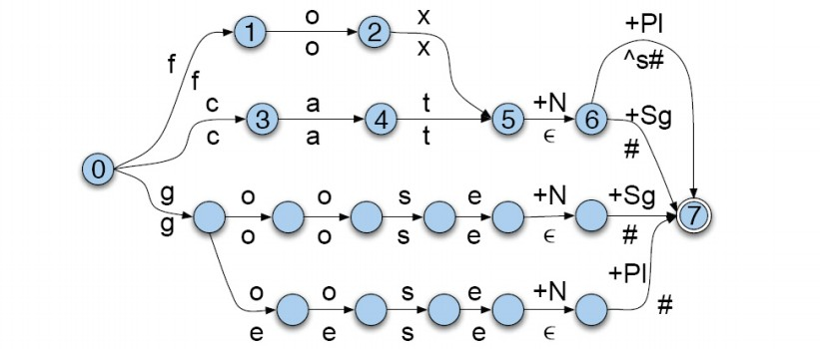
English Nominal Inflection FST
Finite-state methods for morphology
Week 3: Lecture 3

Slide 51
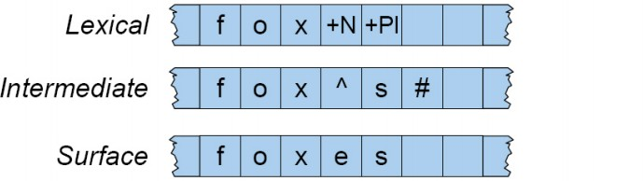
Spelling Handling
A spelling change rule would insert an e only in the appropriate environment.
Finite-state methods for morphology
Week 3: Lecture 3

Slide 52
Rule Handling
Rule Notation
a → b/c_d : “rewrite a as b when it occurs between c and d.”
Finite-state methods for morphology
Week 3: Lecture 3

Slide 53
Morphological Analysis: Approaches
Two different ways to address phonological/graphemic variations
Linguistic approach: A phonological component accompanying the simple concatenative process of attaching an ending
Engineering approach: Phonological changes and irregularities are factored into endings and a higher number of paradigms
Finite-state methods for morphology
Week 3: Lecture 3

Slide 54
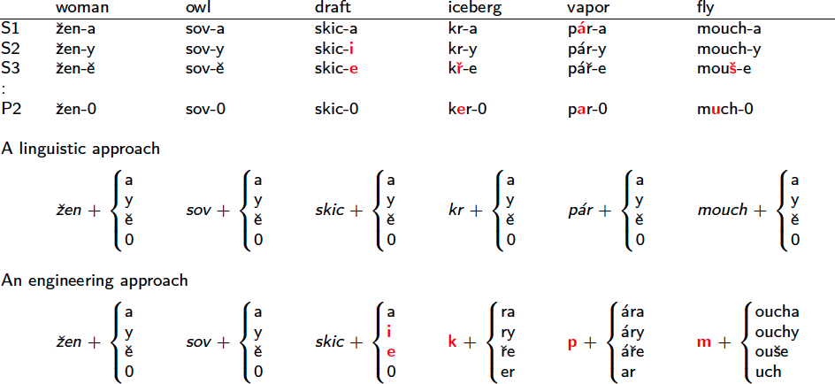
Different Approaches: Example from Czech
Finite-state methods for morphology
Week 3: Lecture 3

Slide 55
Tools Available
AT&T FSM Library and Lextools
http://www2.research.att.com/~fsmtools/fsm/
OpenFST (Google and NYU)
http://www.openfst.org/
Finite-state methods for morphology
Week 3: Lecture 3

Slide 56
Introduction to POS Tagging
Pawan Goyal
CSE, IITKGP
Week 3: Lecture 4
Introduction to POS Tagging
Week 3: Lecture 4
1 / 18

Slide 57
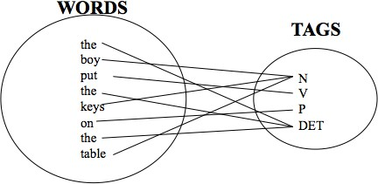
Part-of-Speech (POS) tagging
Task
Given a text of English, identify the parts of speech of each word
Introduction to POS Tagging
Week 3: Lecture 4
2 / 18

Slide 58
Parts of Speech: How many?
Open class words (content words)
nouns, verbs, adjectives, adverbs
mostly content-bearing: they refer to objects, actions, and features in the world
open class, since new words are added all the time
Closed class words
pronouns, determiners, prepositions, connectives, ...
there is a limited number of these
mostly functional: to tie the concepts of a sentence together
Introduction to POS Tagging
Week 3: Lecture 4
3 / 18

Slide 59
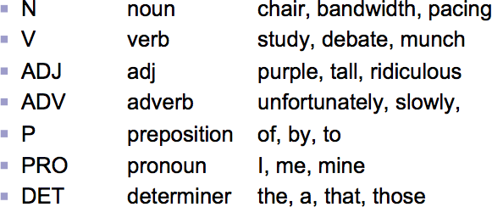
POS examples
Introduction to POS Tagging
Week 3: Lecture 4
4 / 18

Slide 60
POS tagging: Choosing a tagset
To do POS tagging, a standard set needs to be chosen Could pick very coarse tagsets
N, V, Adj, Adv
More commonly used set is finer grained, “UPenn TreeBank tagset”, 45 tags
A Nice Tutorial on POS tags
https://sites.google.com/site/partofspeechhelp/
Introduction to POS Tagging
Week 3: Lecture 4
5 / 18

Slide 61
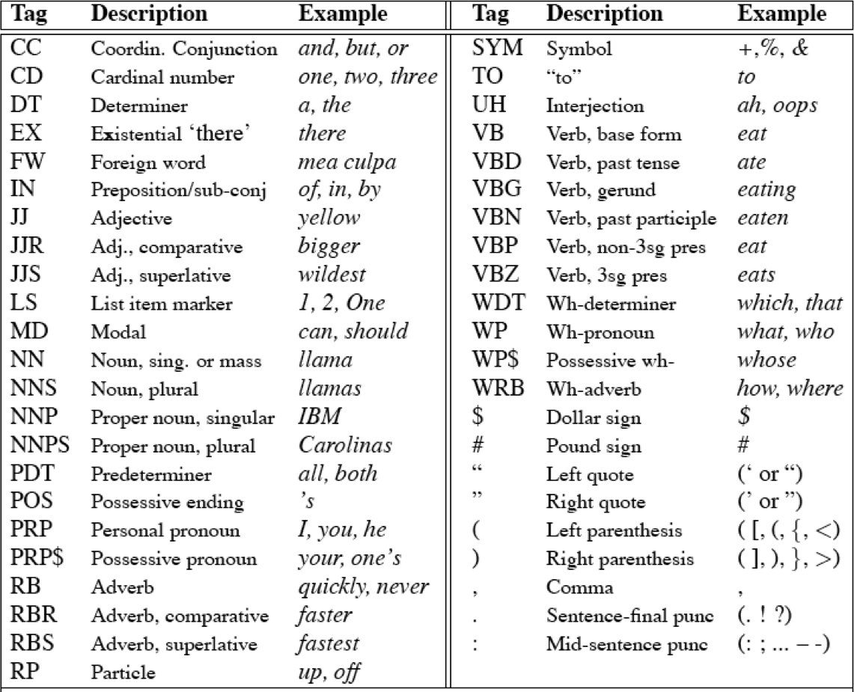
UPenn TreeBank POS tag set
Introduction to POS Tagging
Week 3: Lecture 4
6 / 18

Slide 62
Using the UPenn tagset
Example Sentence
The grand jury commented on a number of other topics.
POS tagged sentence
The/DT grand/JJ jury/NN commmented/VBD on/IN a/DT number/NN of/IN other/JJ topics/NNS ./.
Introduction to POS Tagging
Week 3: Lecture 4
7 / 18

Slide 63
Why is POS tagging hard?
Words often have more than one POS: back
The back door: back/JJ
On my back: back/NN
Win the voters back: back/RB
Promised to back the bill: back/VB
POS tagging problem
To determine the POS tag for a particular instance of a word
Introduction to POS Tagging
Week 3: Lecture 4
8 / 18

Slide 64
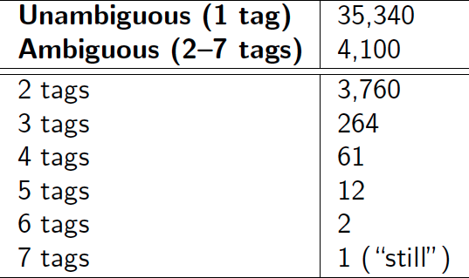
Ambiguous word types in the Brown Corpus
Ambiguity in the Brown corpus
40% of word tokens are ambiguous 12% of word types are ambiguous Breakdown of ambiguous word types:
Introduction to POS Tagging
Week 3: Lecture 4
9 / 18

Slide 65
How bad is the ambiguity problem?
One tag is usually more likely than the others.
In the Brown corpus, race is a noun 98% of the time, and a verb 2% of the time
A tagger for English that simply chooses the most likely tag for each word can achieve good performance
Any new approach should be compared against the unigram baseline (assigning each token to its most likely tag)
Introduction to POS Tagging
Week 3: Lecture 4
10 / 18

Slide 66
Deciding the correct POS
Can be difficult even for people
Mrs./NNP Shaefer/NNP never/RB got/VBD around/_ to/TO joining/VBG.
All/DT we/PRP gotta/VBN do/VB is/VBZ go/VB around/_ the/DT corner/NN.
Chateau/NNP Petrus/NNP costs/VBZ around/_ 2500/CD.
Introduction to POS Tagging
Week 3: Lecture 4

Slide 67
Deciding the correct POS
Can be difficult even for people
Mrs./NNP Shaefer/NNP never/RB got/VBD around/RP to/TO joining/VBG.
All/DT we/PRP gotta/VBN do/VB is/VBZ go/VB around/IN the/DT corner/NN.
Chateau/NNP Petrus/NNP costs/VBZ around/RB 2500/CD.
Introduction to POS Tagging
Week 3: Lecture 4

Slide 68
Relevant knowledge for POS tagging
The word itself
Some words may only be nouns, e.g. arrow
Some words are ambiguous, e.g. like, flies
Probabilities may help, if one tag is more likely than another
Local context
Two determiners rarely follow each other
Two base form verbs rarely follow each other
Determiner is almost always followed by adjective or noun
Introduction to POS Tagging
Week 3: Lecture 4
13 / 18

Slide 69
POS tagging: Two approaches
Rule-based Approach
Assign each word in the input a list of potential POS tags
Then winnow down this list to a single tag using hand-written rules
Statistical tagging
Get a training corpus of tagged text, learn the transformation rules from the most frequent tags (TBL tagger)
Probabilistic: Find the most likely sequence of tags T for a sequence of words W
Introduction to POS Tagging
Week 3: Lecture 4
14 / 18

Slide 70
TBL Tagger
Label the training set with most frequent tags
The can was rusted.
The/DT can/MD was/VBD rusted/VBD.
Add transformation rules to reduce training mistakes
MD →NN: DT_ VBD→VBN: VBD_
Introduction to POS Tagging
Week 3: Lecture 4
15 / 18

Slide 71
Probabilistic Tagging: Two different families of models
Problem at hand
We have some data {(d, c)} of paired observations d and hidden classes c.
Different instances of d and c
Part-of-Speech Tagging: words are observed and tags are hidden.
Text Classification: sentences/documents are observed and the category is hidden.
Categories can be positive/negative for sentiments .. sports/politics/business for documents ...
What gives rise to the two families?
Whether they generate the observed data from hidden stuff or the hidden structure given the data?
Introduction to POS Tagging
Week 3: Lecture 4
16 / 18

Slide 72
Generative vs. Conditional Models
Generative (Joint) Models
Generate the observed data from hidden stuff, i.e. put a probability over the observations given the class: P(d, c) in terms of P(d|c)
e.g. Naïve Bayes’ classifiers, Hidden Markov Models etc.
Discriminative (Conditional) Models
Take the data as given, and put a probability over hidden structure given the data: P(c|d)
e.g. Logistic regression, maximum entropy models, conditional random fields
SVMs, perceptron, etc. are discriminative classifiers but not directly probabilistic
Introduction to POS Tagging
Week 3: Lecture 4
17 / 18

Slide 73
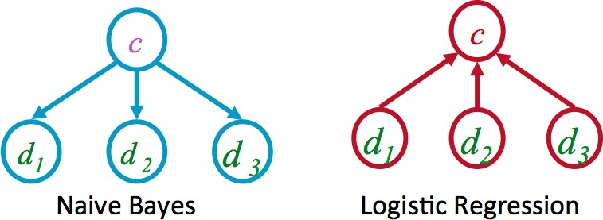
Generative vs. Discriminative Models
Joint vs. conditional likelihood
A joint model gives probabilities P(d, c) and tries to maximize this joint likelihood.
A conditional model gives probabilities P(c|d), taking the data as given and modeling only the conditional probability of the class.
Introduction to POS Tagging
Week 3: Lecture 4
18 / 18

Slide 74
Hidden Markov Models for POS Tagging
Pawan Goyal
CSE, IITKGP
Week 3: Lecture 5
Hidden Markov Models for POS Tagging
Week 3: Lecture 5
1 / 17

Slide 75
Probabilistic Tagging
W = w₁ . . . w_{n} - words in the corpus (observed)
T = t₁ . . . t_{n} - the corresponding tags (unknown)
Tagging: Probabilistic View (Generative Model)
Find
_{T}ˆ
= argmax_{T}P(T|W)
_{argmaxT} P(W|T)P(T)
=
P(W)
= argmax_{T}P(W|T)P(T)
.
= argmax P
(w |w . . . w , t . . . t )P(t |
t . . . t )
T
i 1 i−1 1 i i 1 i−1
i
Hidden Markov Models for POS Tagging
Week 3: Lecture 5
2 / 17

Slide 76
Further simplifications
.
ˆ
T = argmax P
(w |w . . . w , t . . . t )P(t |t . . . t )
T i 1 i−1 1 i i 1 i−1
i
The probability of a word appearing depends only on its own POS tag
P(w_{i}|w₁ . . . w_{i−1}, t₁ . . . t_{i}) ≈ P(w_{i}|t_{i})
Bigram assumption: the probability of a tag appearing depends only on the previous tag
P(t_{i}|t₁ . . . t_{i−1}) ≈ P(t_{i}|t_{i−1})
Using these simplifications:
.
ˆ
T = argmax P
(w |t )P(t |t )
T
i i i i−1
i
Hidden Markov Models for POS Tagging
Week 3: Lecture 5
3 / 17

Slide 77
Computing the probability values
Tag Transition probabilities p(t_{i}|t_{i−1})
C(t_{i−1}, t_{i}) C(t_{i−1})
P(t_{i}|t_{i−1}) =
C(DT, NN) 56
, 509
P(NN|
DT) =
=
= 0.49
C(DT) 116, 454
Word Likelihood probabilities p(w_{i}|t_{i})
C(t_{i}, w_{i})
P(w |t ) =
i i
C(t_{i})
C(VBZ, is) 10
, 073
P(is|VBZ) =
=
= 0.47
C(VBZ) 21, 627
Hidden Markov Models for POS Tagging
Week 3: Lecture 5
4 / 17

Slide 78
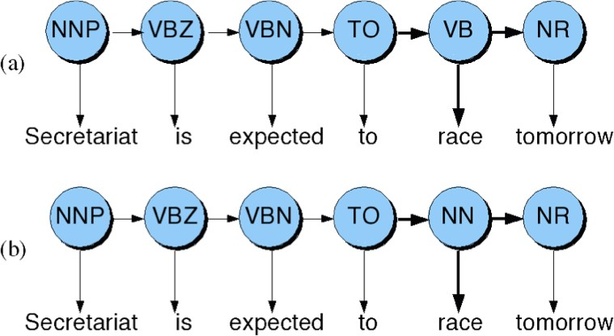
Disambiguating “race”
Hidden Markov Models for POS Tagging
Week 3: Lecture 5
5 / 17

Slide 79
Disambiguating “race”
Difference in probability due to P(VB|TO) vs. P(NN|TO)
P(race|VB) vs. P(race|NN) P(NR|VB) vs. P(NR|NN)
After computing the probabilities
P(NN|TO)P(NR|NN)P(race|NN) = 0.0047 × 0.0012 × 0.00057 =
0.00000000032
P(VB|TO)P(NR|VB)P(race|VB) = 0.83 × 0.0027 × 0.00012 = 0.00000027
Hidden Markov Models for POS Tagging
Week 3: Lecture 5
6 / 17

Slide 80
What is this model?
This is a Hidden Markov Model
Hidden Markov Models for POS Tagging
Week 3: Lecture 5
7 / 17

Slide 81
Hidden Markov Models
Tag Transition probabilities p(t_{i}|t_{i−1})
Word Likelihood probabilities (emissions) p(w_{i}|t_{i})
What we have described with these probabilities is a hidden markov model.
Let us quickly introduce the Markov Chain, or observable Markov Model.
Hidden Markov Models for POS Tagging
Week 3: Lecture 5
8 / 17

Slide 82
Markov Chain = First-order Markov Model
Weather example
Three types of weather: sunny, rainy, foggy
q_{n}: variable denoting the weather on the n^{th} day
We want to find the following conditional probabilities:
P(q_{n}|q_{n−1}, q_{n−2},..., q₁)
First-order Markov Assumption
P(q_{n}|q_{n−1}, q_{n−2},..., q₁) = P(q_{n}|q_{n−1})
Hidden Markov Models for POS Tagging
Week 3: Lecture 5
9 / 17

Slide 83
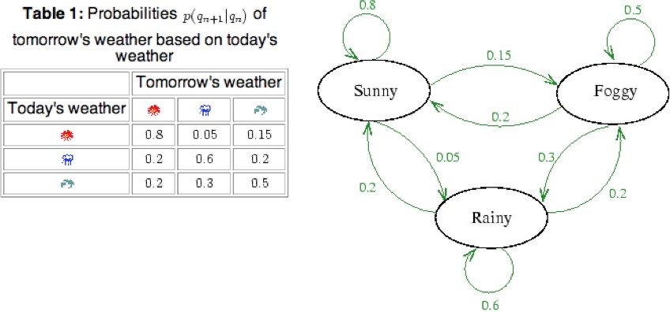
Markov Chain Transition Table
Hidden Markov Models for POS Tagging
Week 3: Lecture 5

Slide 84
Using Markov Chain
Given that today the weather is sunny, what is the probability that tomorrow is sunny and day after is rainy?
P(q₂ = sunny, q₃ = rainy|q₁ = sunny)
= P(q₃ = rainy|q₂ = sunny, q₁ = sunny) × P(q₂ = sunny|q₁ = sunny)
= P(q₃ = rainy|q₂ = sunny) × P(q₂ = sunny|q₁ = sunny)
= 0.05 × 0.8
= 0.04
Hidden Markov Models for POS Tagging
Week 3: Lecture 5
11 / 17

Slide 85
Hidden Markov Model
For Markov chains, the output symbols are the same as the states
‘sunny’ weather is both observable and state
But in POS tagging
The output symbols are words
But the hidden states are POS tags
A Hidden Markov Model is an extension of a Markov chain in which the output symbols are not the same as the states
We don’t know which state we are in
Hidden Markov Models for POS Tagging
Week 3: Lecture 5
12 / 17

Slide 86
Hidden Markov Models (HMMs)
Elements of an HMM model
A set of states (here: the tags) An output alphabet (here: words)
Initial state (here: beginning of sentence) State transition probabilities (here p(t_{n}|t_{n−1})) Symbol emission probabilities (here p(w_{i}|t_{i}))
Hidden Markov Models for POS Tagging
Week 3: Lecture 5

Slide 87
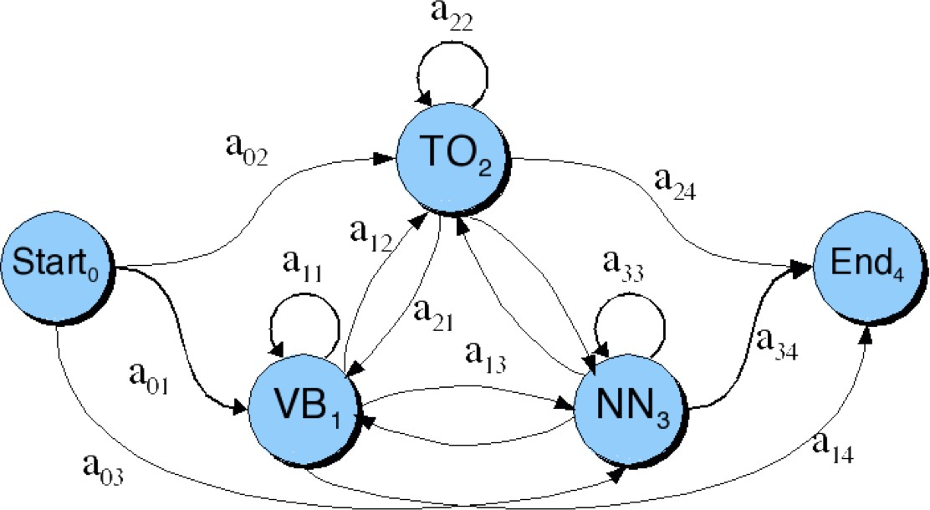
Graphical Representation
When tagging a sentence, we are walking through the state graph:
Edges are labeled with the state transition probabilities: p(t_{n}|t_{n−1})
Hidden Markov Models for POS Tagging
Week 3: Lecture 5

Slide 88
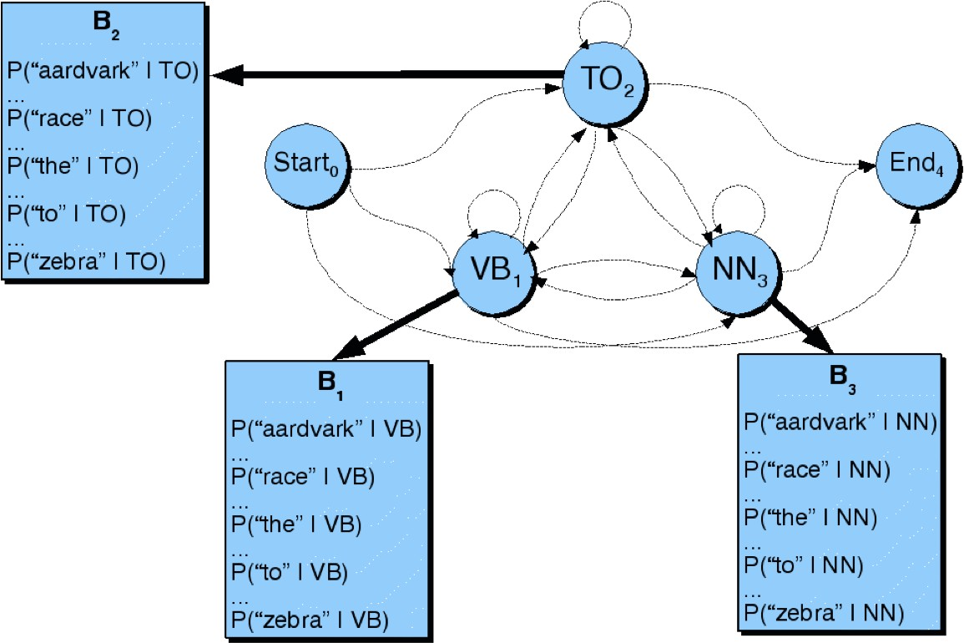
Graphical Representation
At each state we emit a word: P(w_{n}|t_{n})
Hidden Markov Models for POS Tagging
Week 3: Lecture 5

Slide 89
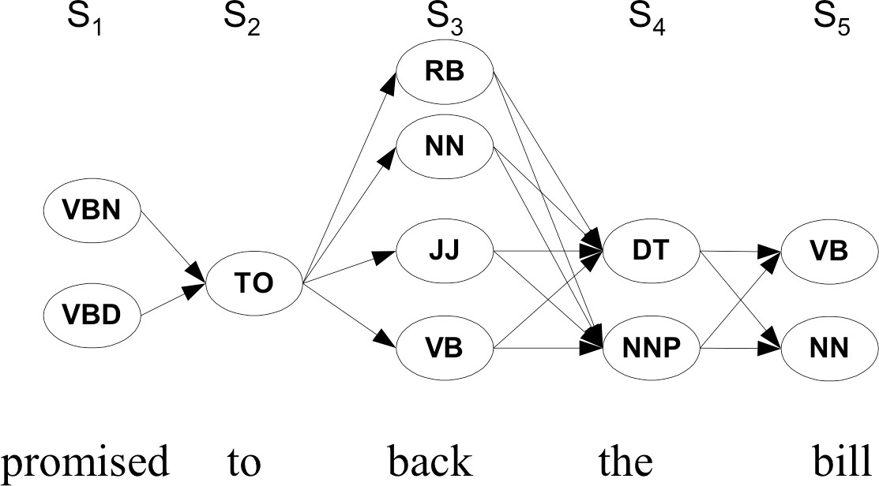
Walking through the states: best path
Hidden Markov Models for POS Tagging
Week 3: Lecture 5

Slide 90
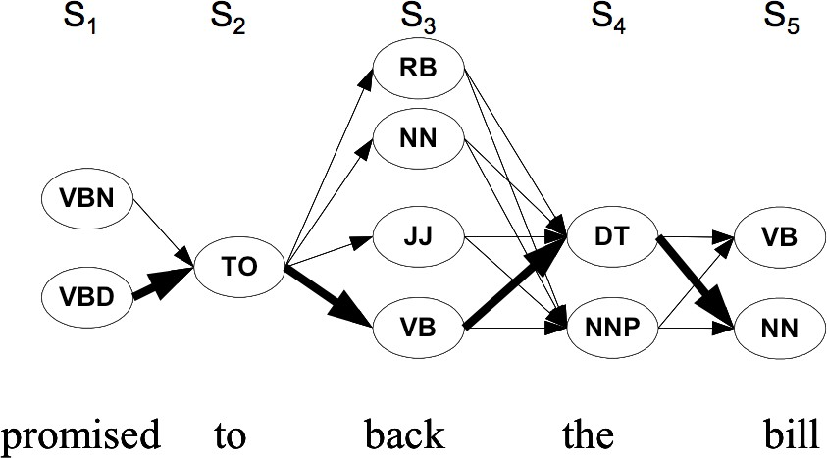
Walking through the states: best path
Hidden Markov Models for POS Tagging
Week 3: Lecture 5

